Slide 1

Kubernetes
Kubernetes
A Container Orchestration Tool

Slide 2
Topics ?
• Introduction of Kubernetes
• Features of Kubernetes
• Architecture of Kubernetes
• Nodes in Kubernetes
• PODs in Kubernetes
• Replicas in Kubernetes
• Services in Kubernetes
• Deployment in Kubernetes
• Introduction of Kubernetes
• Features of Kubernetes
• Architecture of Kubernetes
• Nodes in Kubernetes
• PODs in Kubernetes
• Replicas in Kubernetes
• Services in Kubernetes
• Deployment in Kubernetes

Slide 3
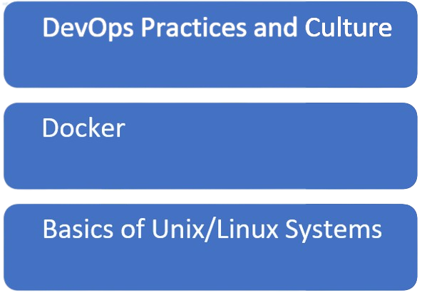
Pre-requisites
Pre-requisites

Slide 4
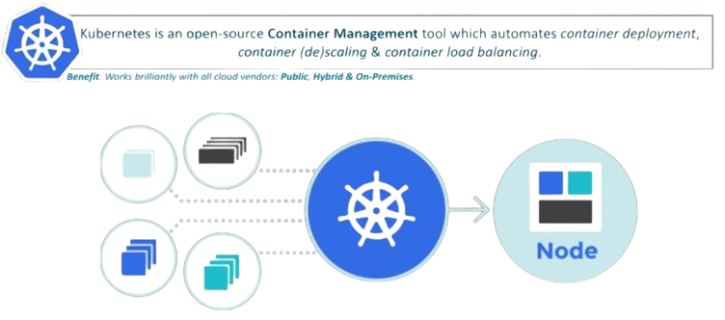
What is Kubernetes ?
.

Slide 5
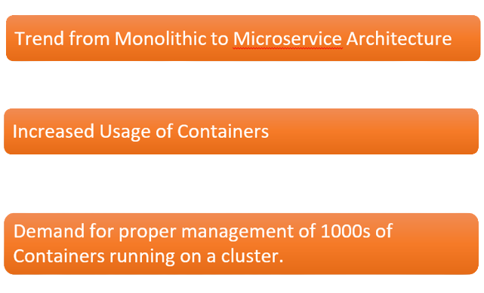
Why Do we need a Container Orchestration Tool?
.

Slide 6
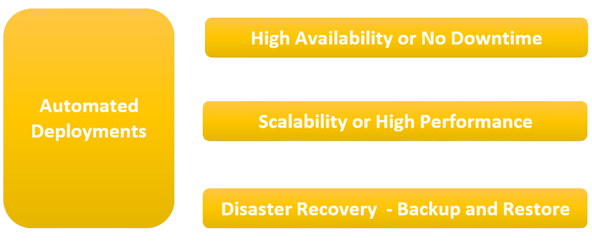
What does a container Orchestration Tool Offers ?
.

Slide 7
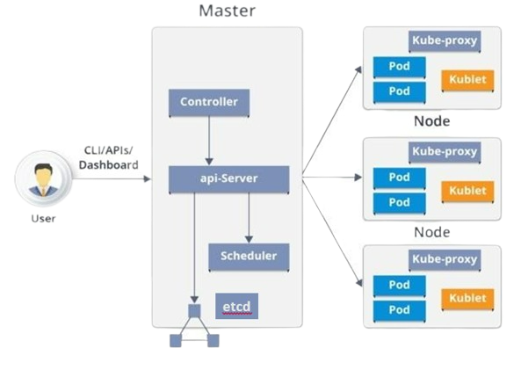
Kubernetes Architecture
Kubernetes has the following main components:
– Master nodes
– Worker nodes
– Distributed key-value store, like etcd.

Slide 8
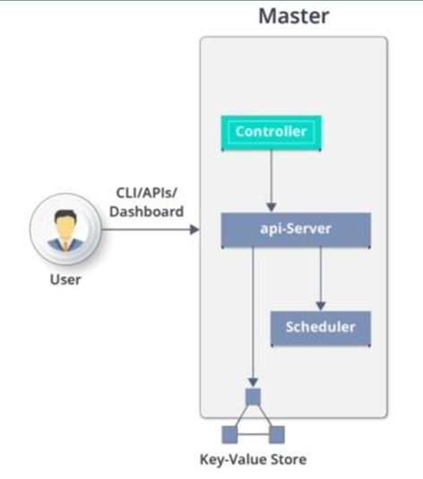
Kubernetes Architecture - Master Node Components
A Master node has the following components :
API server
Scheduler
Controller manager
Etcd.

Slide 9
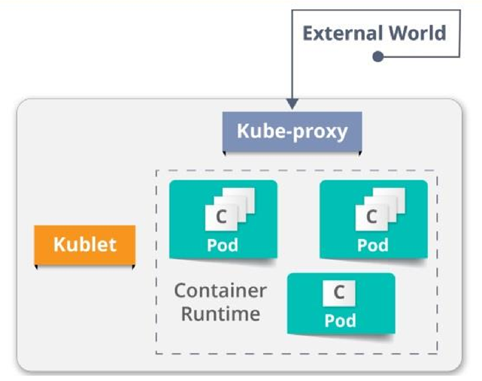
Worker Node
.

Slide 10
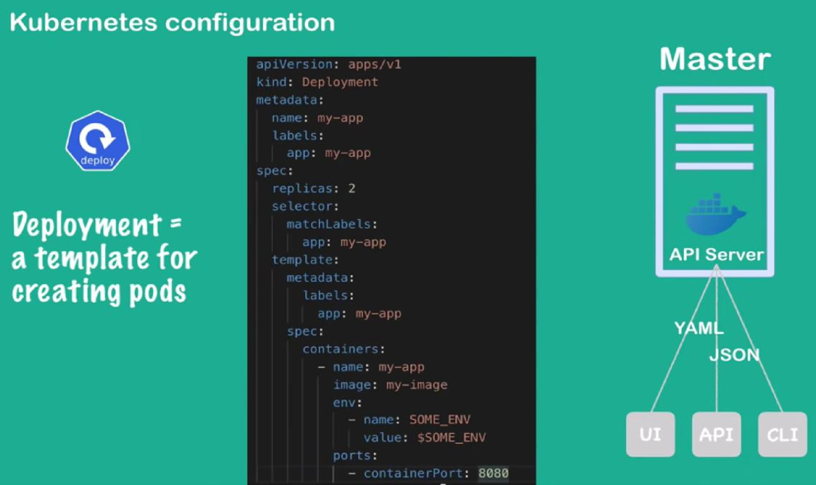
Kubernetes Configuration
.

Slide 11
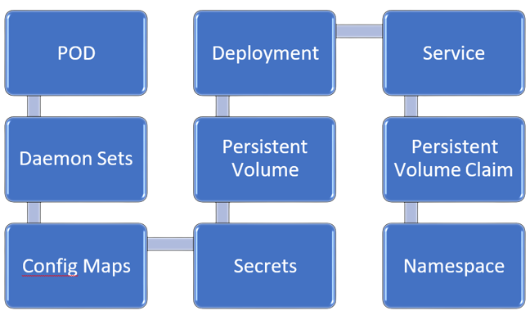
Kubernetes Resources
.

Slide 12
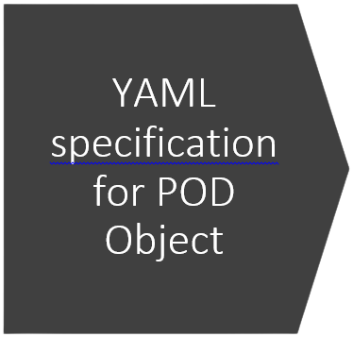
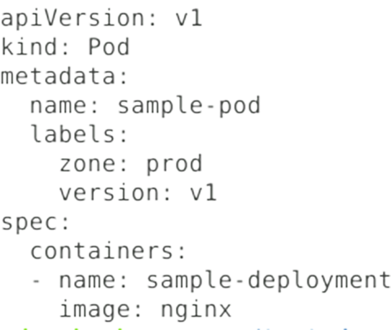
Hands-on
.

Slide 13
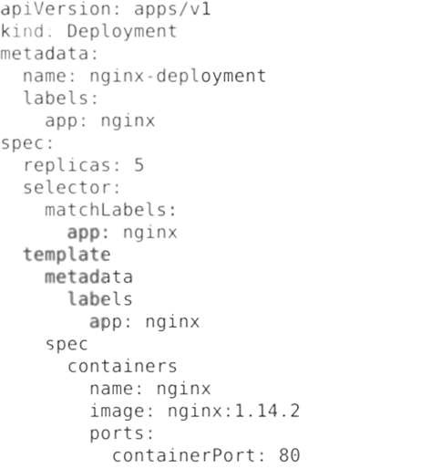
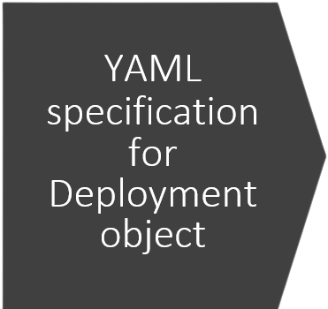
Hands-on
.

Slide 14
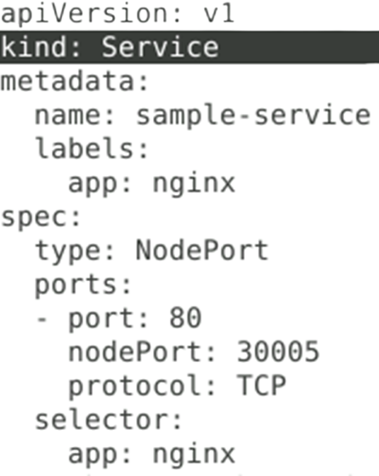
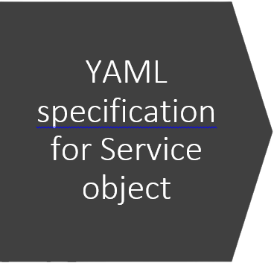
Hands-On
.

Slide 15
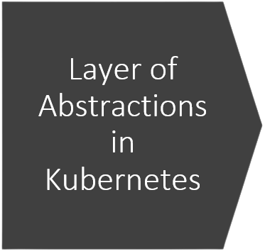
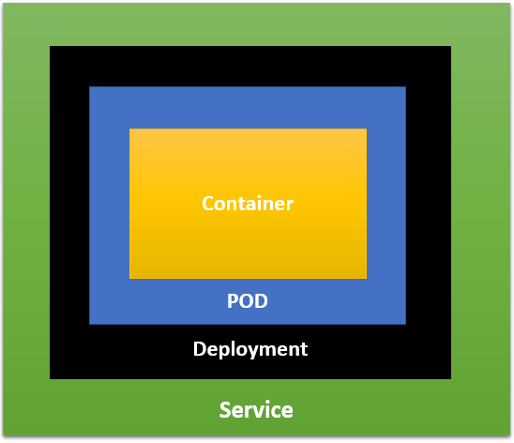
Layer of Abstractions in Kubernetes
.

Slide 16
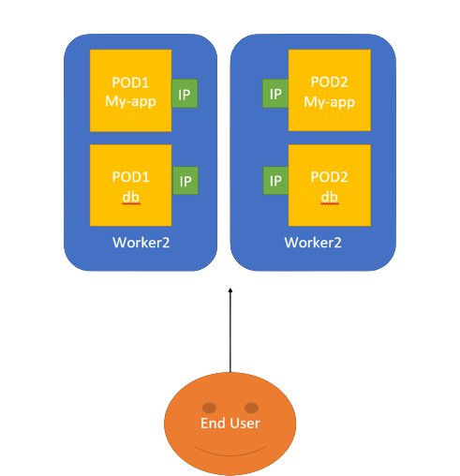
Application Pods
How do our application pods get exposed to the outside world?

Slide 17
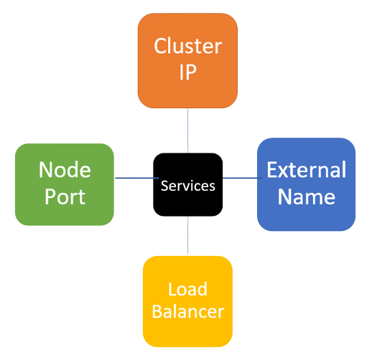
Application Pods
.

Slide 18
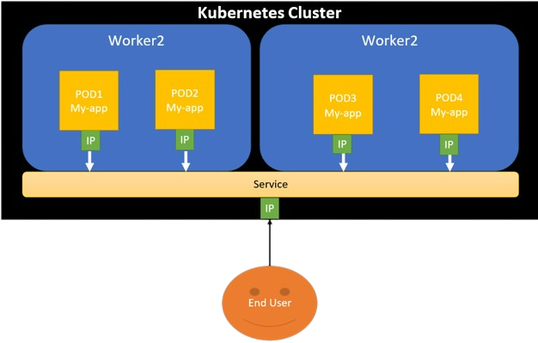
Kubernetes cluster
.

